Slide 1

Smart Pantry: Recipe Recommender & Grocery Planner
Presented by: CodeCooks Batch: 09
Our Team:
Nikhil Vadhwani – S25CSEU0261
Kabeer Rangan – S25CSEU0243
Bhavishya Tyagi – S25CSEU0255
Aarush Agrawal – S25CSEU0251
Sankalp Tuteja – S25CSEU0271

Slide 2




The Problem We're Solving: Food Waste & Meal Planning Woes
Ingredient Uncertainty
Preventable Waste
People often don't know what to cook with the ingredients they already have on hand, leading to mealtime dilemmas.
Fresh ingredients, especially vegetables, frequently go to waste because they are forgotten or unused before expiring.
Diverse Dietary Needs
Manual Recipe Checking
Vegetarians, non-vegetarians, and diet-focused individuals all have specific food choices and preferences that complicate meal planning.
It's challenging to manually cross-reference available ingredients with various recipes to see what's possible and what's missing.
Our project addresses these challenges by offering a simple, intuitive tool to manage pantry items and provide quick, personalized recipe suggestions based on what you already have.

Slide 3





Our Project Objectives: Building a Smart Pantry
Beginner-Friendly Python
Develop a simple Python program to manage pantry ingredients.
Intelligent Recipe Suggestions
Suggest recipes based on the ingredients currently available in the user's pantry.
Highlight Missing Items
Clearly display any missing ingredients needed to complete a recipe.
Support Dietary Categories
Include support for Vegetarian, Non-Vegetarian, and Diet-Friendly meal options.
Recipe Filtering
Allow users to easily filter recipes by their preferred food type or dietary category.

Slide 4
How Smart Pantry Works: Your Personal Kitchen Assistant
01
02
03
Add Pantry Items
Compare Ingredients
Ready-to-Make Recipes
The user inputs the items they currently have at home into their digital pantry list.
The program automatically compares the user's pantry items against the ingredient list for each recipe.
If all necessary ingredients are present, the recipe is displayed as "Ready to Make."
04
05
Identify Missing Items
Filter by Category
If some ingredients are absent, the program clearly lists the missing items for easy grocery planning.
Users can also filter recipes to find options that are Vegetarian, Non-Vegetarian, or Diet-Friendly.
Our code diligently checks each recipe, compares ingredients, and shows what's possible with a simple text-based menu, making it easy to use for everyone.

Slide 5
Python Fundamentals Powering Smart Pantry
Dictionaries
Lists
Used to efficiently store and organize recipes, including their ingredients and dietary categories.
Implemented to manage and keep track of all the items currently in the user's pantry.
Loops
If-Conditions
Essential for iterating through recipes and comparing their ingredients with the user's pantry contents.
Crucial for determining whether a recipe can be made ("ready") or if ingredients are missing.
Functions
User Input
Our code utilizes functions for better organization and readability, breaking down complex tasks into manageable blocks.
A menu-driven console interface allows users to easily interact with the program.

Slide 6
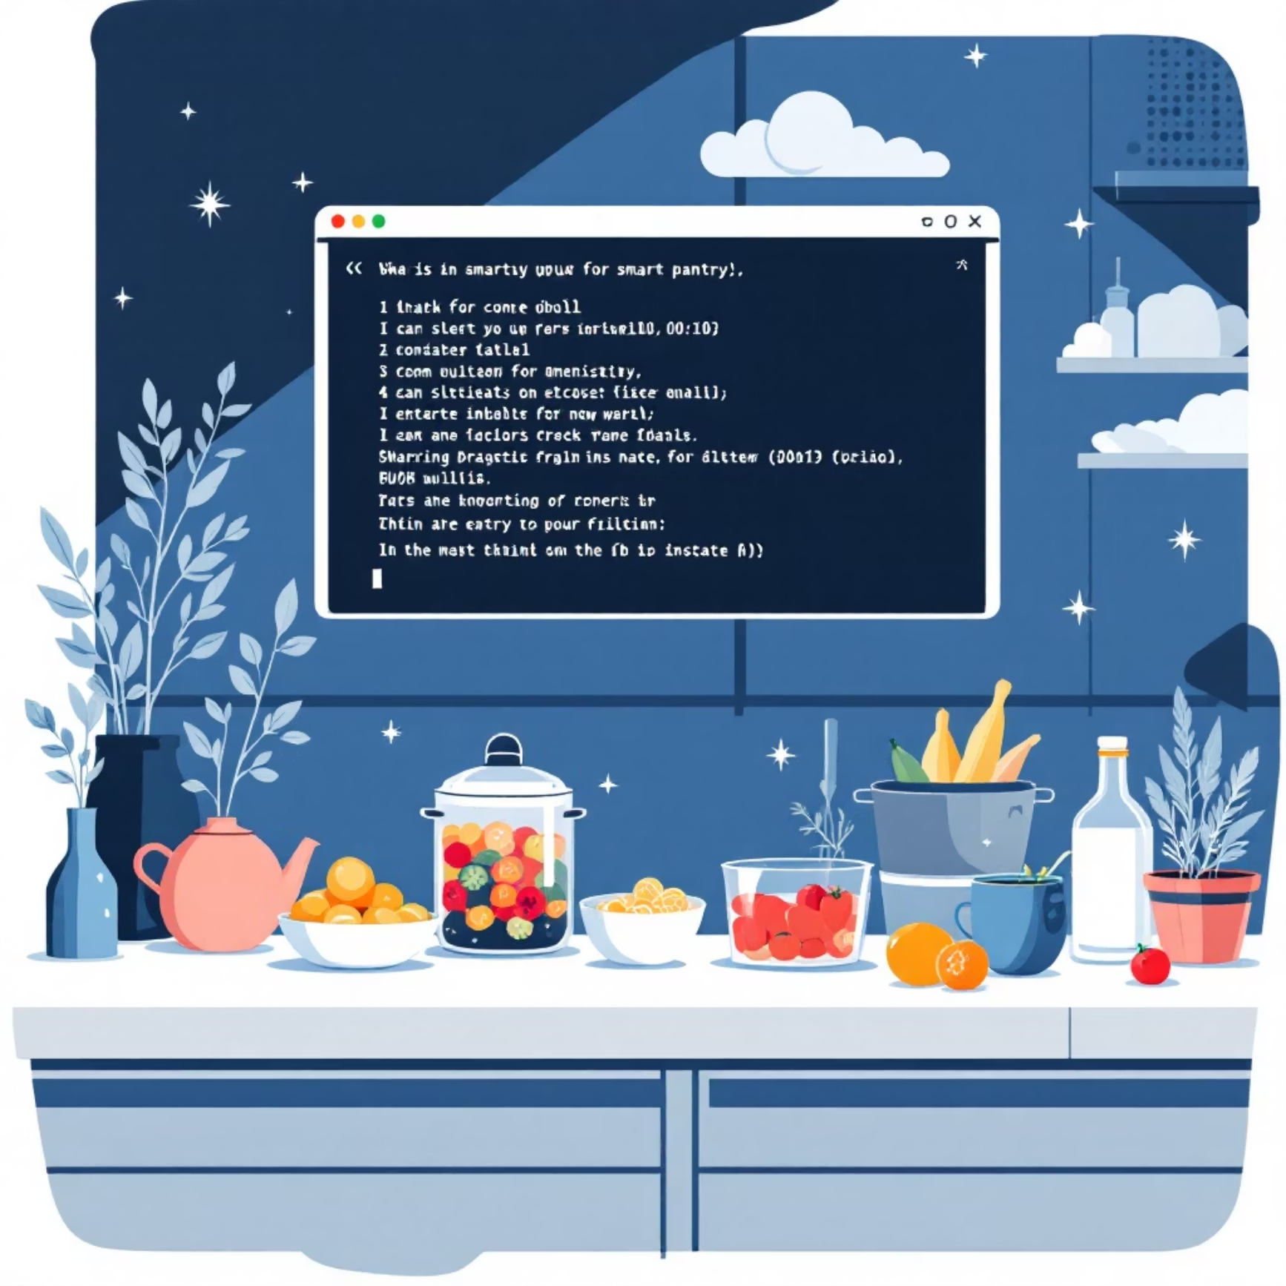
Smart Pantry in Action: A Quick Demo
Welcome to Smart Pantry!
Add item to pantry.2
View pantry items
3. Show recipes you can make
4. Filter recipes by category (veg / non-veg / diet)
5. Exit.
>>>Enter your choice: 3
Our intuitive menu makes navigating the Smart Pantry a breeze. Simply choose an option to get started.
Checking available recipes...

Slide 7





CodeCooks: Our Team Contributions
Nikhil Vadhwani
Developed the core logic and recipe comparison engine.
Kabeer Rangan
Designed the pantry input system and managed menu flow.
Bhavishya Tyagi
Compiled and integrated veg, non-veg, and diet recipe data.
Aarush Agrawal
Responsible for PPT design and project documentation.
Sankalp Tuteja
Led debugging efforts and ensured consistent code formatting.

Slide 8


Beyond the Basics: Applications & Future Scope
Current Applications
Future Enhancements
Reduces Food Waste: Helps users utilize existing ingredients before they spoil.
Mobile App Integration: Evolve into a user-friendly mobile application for on-the-go access.
Saves Time: Streamlines daily cooking decisions and meal planning.
Calorie Calculation: Add nutritional information and calorie tracking for diet plans.
Student-Friendly: Ideal for students managing limited pantry supplies in hostels or dorms.
Permanent Data Storage: Implement database integration to save pantry data persistently.
Ingredient Expiry Tracking: Introduce features to monitor and alert users about expiring ingredients.

Slide 9

Thank You!
We hope Smart Pantry inspires you to make the most of your kitchen.
"Cooking is like love. It should be entered into with abandon or not at all." – Harriet Van Horne
Questions? Feel free to ask!

